Slide 1
Introduction to Neural Networks

Slide 2
What are connectionist neural networks?
Connectionism refers to a computer modeling approach to computation that is loosely based upon the architecture of the brain.
Many different models, but all include:
  Multiple, individual “nodes” or “units” that operate at the same time (in parallel)
  A network that connects the nodes together
  Information is stored in a distributed fashion among the links that connect the nodes
  Learning can occur with gradual changes in connection strength

Slide 3
Neural Network History
History traces back to the 50’s but became popular in the 80’s with work by Rumelhart, Hinton, and Mclelland
  A General Framework for Parallel Distributed Processing in Parallel Distributed Processing: Explorations in the Microstructure of Cognition
Peaked in the 90’s. Today:
  Hundreds of variants
  Less a model of the actual brain than a useful tool, but still some debate
Numerous applications
  Handwriting, face, speech recognition
  Vehicles that drive themselves
  Models of reading, sentence production, dreaming
Debate for philosophers and cognitive scientists
  Can human consciousness or cognitive abilities be explained by a connectionist model or does it require the manipulation of symbols?

Slide 4
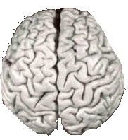

Comparison of Brains and Traditional Computers
200 billion neurons, 32 trillion synapses
Element size: 10⁻⁶ m
Energy use: 25W
Processing speed: 100 Hz
Parallel, Distributed
Fault Tolerant
Learns: Yes
Intelligent/Conscious: Usually
1 billion bytes RAM but trillions of bytes on disk
Element size: 10⁻⁹ m
Energy watt: 30-90W (CPU)
Processing speed: 10⁹ Hz
Serial, Centralized
Generally not Fault Tolerant
Learns: Some
Intelligent/Conscious: Generally No

Slide 5
Biological Inspiration
Idea : To make the computer more robust, intelligent, and learn, …
Let’s model our computer software (and/or hardware) after the brain
“My brain: It's my second favorite organ.”
- Woody Allen, from the movie Sleeper

Slide 6
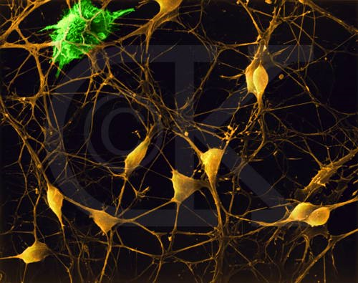
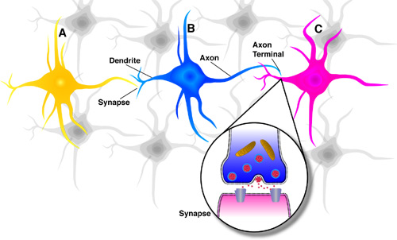
Neurons in the Brain
Although heterogeneous, at a low level the brain is composed of neurons
  A neuron receives input from other neurons (generally thousands) from its synapses
  Inputs are approximately summed
  When the input exceeds a threshold the neuron sends an electrical spike that travels that travels from the body, down the axon, to the next neuron(s)

Slide 7
Learning in the Brain
Brains learn
  Altering strength between neurons
  Creating/deleting connections
Hebb’s Postulate (Hebbian Learning)
  When an axon of cell A is near enough to excite a cell B and repeatedly or persistently takes part in firing it, some growth process or metabolic change takes place in one or both cells such that A's efficiency, as one of the cells firing B, is increased.
Long Term Potentiation (LTP)
  Cellular basis for learning and memory
  LTP is the long-lasting strengthening of the connection between two nerve cells in response to stimulation
  Discovered in many regions of the cortex

Slide 8

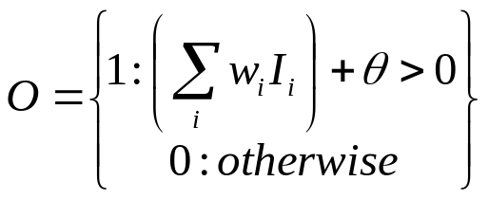
Perceptrons
Initial proposal of connectionist networks
Rosenblatt, 50’s and 60’s
Essentially a linear discriminant composed of nodes, weights
I1
W1
I1
W1
or
W2
W2
O
I2
O
I2
W3
W3
I3
Activation Function
I3
1

Slide 9
Perceptron Example
2
.5
.3
=-1
1
2(0.5) + 1(0.3) + -1 = 0.3 , O=1
Learning Procedure:
Randomly assign weights (between 0-1)
Present inputs from training data
Get output O, nudge weights to gives results toward our desired output T
Repeat; stop when no errors, or enough epochs completed

Slide 10
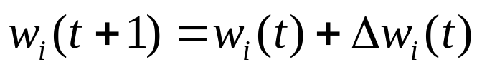
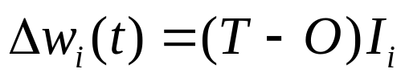


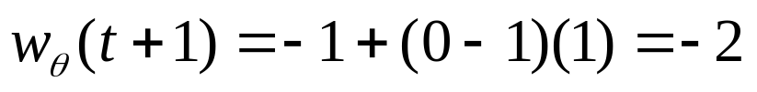
Perception Training
Weights include Threshold. T=Desired, O=Actual output.
Example: T=0, O=1, W1=0.5, W2=0.3, I1=2, I2=1,Theta=-1
If we present this input again, we’d output 0 instead

Slide 11
Matlab Code
I = [0 0 1 1; 0 1 0 1];
T = [0 1 1 1];
net = perceptron;
net = train(net,I,T);
view(net)
y = net(x);

Slide 12
How might you use a perceptron network?
This (and other networks) are generally used to learn how to make classifications
Say you have collected some data regarding the diagnosis of patients with heart disease
  Age, Sex, Chest Pain Type, Resting BPS, Cholesterol, …, Diagnosis (<50% diameter narrowing, >50% diameter narrowing)
  67,1,4,120,229,…, 1
  37,1,3,130,250,… ,0
  41,0,2,130,204,… ,0
Train network to predict heart disease of new patient

Slide 13
Perceptrons
Can add learning rate to speed up the learning process; just multiply in with delta computation
Essentially a linear discriminant
Perceptron theorem: If a linear discriminant exists that can separate the classes without error, the training procedure is guaranteed to find that line or plane.
'E:\MATLAB_installed\examples\nnet\main\demop1.mlx'
Class1
Class2

Slide 14
Exclusive Or (XOR) Problem
1
0
Input: 0,0 Output: 0
Input: 0,1 Output: 1
Input: 1,0 Output: 1
Input: 1,1 Output: 0
0
1
XOR Problem: Not Linearly Separable!
We could however construct multiple layers of perceptrons to get around this problem. A typical multi-layered system minimizes LMS Error,

Slide 15
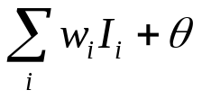
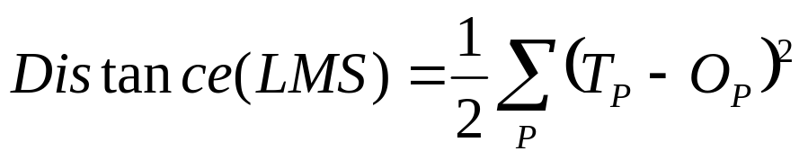
LMS Learning
LMS = Least Mean Square learning Systems, more general than the previous perceptron learning rule. The concept is to minimize the total error, as measured over all training examples, P. O is the raw output, as calculated by
E.g. if we have two patterns and
T1=1, O1=0.8, T2=0, O2=0.5 then D=(0.5)[(1-0.8)²+(0-0.5)²]=.145
We want to minimize the LMS:
C-learning rate
E
W(old)
W(new)
W

Slide 16
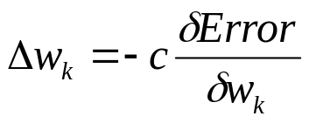

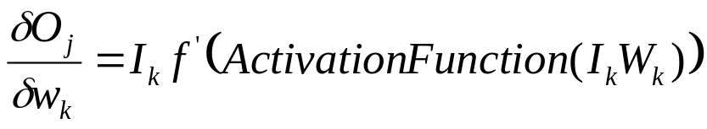
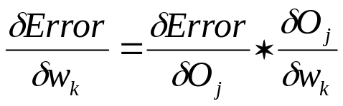
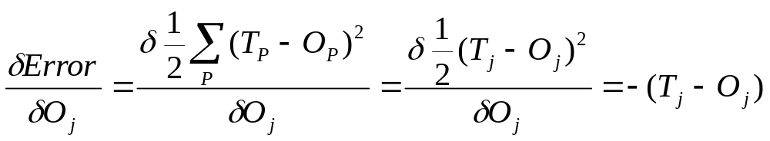
LMS Gradient Descent
Using LMS, we want to minimize the error. We can do this by finding the direction on the error surface that most rapidly reduces the error rate; this is finding the slope of the error function by taking the derivative. The approach is called gradient descent (similar to hill climbing).
To compute how much to change weight for link k:
Chain rule:
We can remove the sum since we are taking the partial derivative wrt Oj

Slide 17
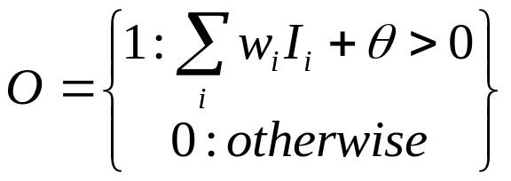
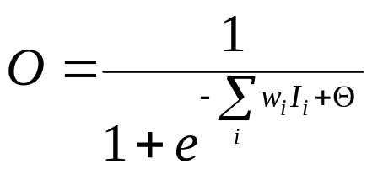

Activation Function
To apply the LMS learning rule, also known as the delta rule, we need a differentiable activation function.
Old:
New:

Slide 18
LMS vs. Limiting Threshold
With the new sigmoidal function that is differentiable, we can apply the delta rule toward learning.
Perceptron Method
  Forced output to 0 or 1, while LMS uses the net output
  Guaranteed to separate, if no error and is linearly separable
    Otherwise it may not converge
Gradient Descent Method:
  May oscillate and not converge
  May converge to wrong answer
  Will converge to some minimum even if the classes are not linearly separable, unlike the earlier perceptron training method

Slide 19
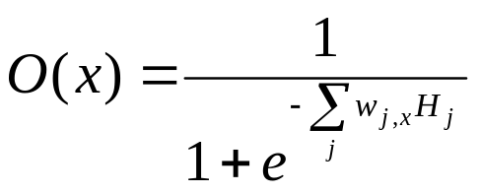
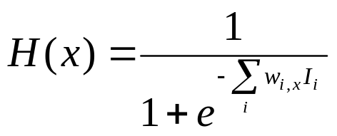
Backpropagation Networks
Attributed to Rumelhart and McClelland, late 70’s
To bypass the linear classification problem, we can construct multilayer networks. Typically we have fully connected, feedforward networks.
Input Layer
Hidden Layer
Output Layer
I1
O1
H1
I2
H2
O2
I3
W_{i,j}
1
W_{j,k}
1
1’s - bias

Slide 20
Backprop - Learning
Learning Procedure:
Randomly assign weights (between 0-1)
Present inputs from training data, propagate to outputs
Compute outputs O, adjust weights according to the delta rule, backpropagating the errors. The weights will be nudged closer so that the network learns to give the desired output.
Repeat; stop when no errors, or enough epochs completed

Slide 21
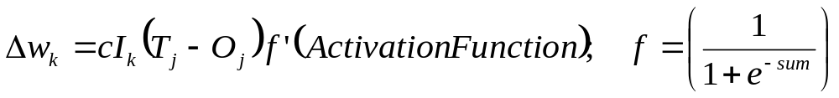
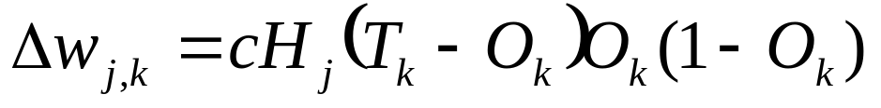
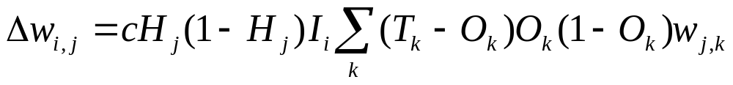
Backprop - Modifying Weights
We had computed:
For the Output unit k, f(sum)=O(k). For the output units, this is:
For the Hidden units (skipping some math), this is:
I
H
O
W_{i,j}
W_{j,k}

Slide 22
Backprop
Very powerful - can learn any function, given enough hidden units! With enough hidden units, we can generate any function.
Have the same problems of Generalization vs. Memorization. With too many units, we will tend to memorize the input and not generalize well. Some schemes exist to “prune” the neural network.
Networks require extensive training, many parameters to fiddle with. Can be extremely slow to train. May also fall into local minima.
Inherently parallel algorithm, ideal for multiprocessor hardware.
Despite the cons, a very powerful algorithm that has seen widespread successful deployment.

Slide 23
Backprop Demo
QwikNet
  Learning XOR, Sin/Cos functions

Slide 24
Unsupervised Learning
We just discussed a form of supervised learning
  A “teacher” tells the network what the correct output is based on the input until the network learns the target concept
We can also train networks where there is no teacher. This is called unsupervised learning. The network learns a prototype based on the distribution of patterns in the training data. Such networks allow us to:
  Discover underlying structure of the data
  Encode or compress the data
  Transform the data

Slide 25
Unsupervised Learning – Hopfield Networks
A Hopfield network is a type of content-addressable memory
  Non-linear system with attractor points that represent concepts
  Given a fuzzy input the system converges to the nearest attractor
    Possibility to have “spurious” attractors that is a blend of multiple stored patterns
    Also possible to have chaotic patterns that never converge

Slide 26
Standard Binary Hopfield Network
Recurrent; Every unit is connected to every other unit
Weights connecting units are symmetrical
  w_{ij} = w_{ji}
If the weighted sum of the inputs exceeds a threshold, its output is 1 otherwise its output is -1
Units update themselves asynchronously as their inputs change
A
w_{AD}
w_{AB}
w_{AC}
B
w_{BC}
w_{BD}
C
D
w_{CD}

Slide 27
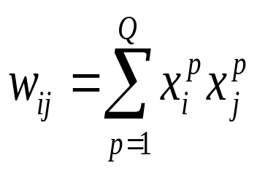
Hopfield Memories
Setting the weights:
  A pattern is a setting of on or off for each unit
  Given a set of Q patterns to store
    For every weight connecting units i and j:
    This is a form of a Hebbian rule which makes the weight strength proportional to the product of the firing rates of the two interconnected units

Slide 28
Hopfield Network Demo
http://www.cbu.edu/~pong/ai/hopfield/hopfieldapplet.html
Properties
  Settles into a minimal energy state
  Storage capacity low, only 13% of number of units
  Can retrieve information even in the presence of noisy data, similar to associative memory of humans

Slide 29
Unsupervised Learning – Self Organizing Maps
Self-organizing maps (SOMs) are a data visualization technique invented by Professor Teuvo Kohonen
  Also called Kohonen Networks, Competitive Learning, Winner-Take-All Learning
  Generally reduces the dimensions of data through the use of self-organizing neural networks
  Useful for data visualization; humans cannot visualize high dimensional data so this is often a useful technique to make sense of large data sets

Slide 30
Basic “Winner Take All” Network
Two layer network
  Input units, output units, each input unit is connected to each output unit
Input Layer
Output Layer
I1
O1
I2
O2
I3
W_{i,j}

Slide 31
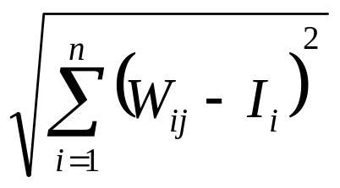
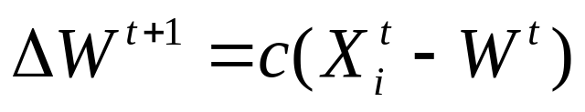
Basic Algorithm
  Initialize Map (randomly assign weights)
  Loop over training examples
    Assign input unit values according to the values in the current example
    Find the “winner”, i.e. the output unit that most closely matches the input units, using some distance metric, e.g.
    Modify weights on the winner to more closely match the input
For all output units j=1 to m
and input units i=1 to n
Find the one that minimizes:
where c is a small positive learning constant
that usually decreases as the learning proceeds

Slide 32
Result of Algorithm
Initially, some output nodes will randomly be a little closer to some particular type of input
These nodes become “winners” and the weights move them even closer to the inputs
Over time nodes in the output become representative prototypes for examples in the input
Note there is no supervised training here
Classification:
  Given new input, the class is the output node that is the winner

Slide 33
Typical Usage: 2D Feature Map
In typical usage the output nodes form a 2D “map” organized in a grid-like fashion and we update weights in a neighborhood around the winner
Output Layers
Input Layer
O11
O12
O13
O14
O15
I1
O21
O22
O23
O24
O25
I2
O31
O32
O33
O34
O35
…
O41
O42
O43
O44
O45
I3
O51
O52
O53
O54
O55

Slide 34
Modified Algorithm
  Initialize Map (randomly assign weights)
  Loop over training examples
    Assign input unit values according to the values in the current example
    Find the “winner”, i.e. the output unit that most closely matches the input units, using some distance metric, e.g.
    Modify weights on the winner to more closely match the input
    Modify weights in a neighborhood around the winner so the neighbors on the 2D map also become closer to the input
      Over time this will tend to cluster similar items closer on the map

Slide 35
Updating the Neighborhood
Node O₄₄ is the winner
  Color indicates scaling to update neighbors
Output Layers
O11
O12
O13
O14
O15
O21
O22
O23
O24
O25
c=1
Consider if O₄₂ is winner for some other input; “fight” over claiming O₄₃, O₃₃, O₅₃
O31
O32
O33
O34
O35
c=0.75
O41
O42
O43
O44
O45
c=0.5
O51
O52
O53
O54
O55

Slide 36

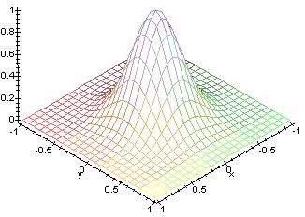
Selecting the Neighborhood
Typically, a “Sombrero Function” or Gaussian function is used
Neighborhood size usually decreases over time to allow initial “jockeying for position” and then “fine-tuning” as algorithm proceeds

Slide 37
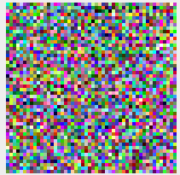
Color Example
http://davis.wpi.edu/~matt/courses/soms/applet.html

Slide 38
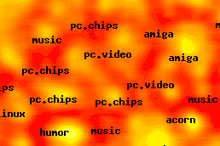
Kohonen Network Examples
Document Map: http://websom.hut.fi/websom/milliondemo/html/root.html

Slide 39
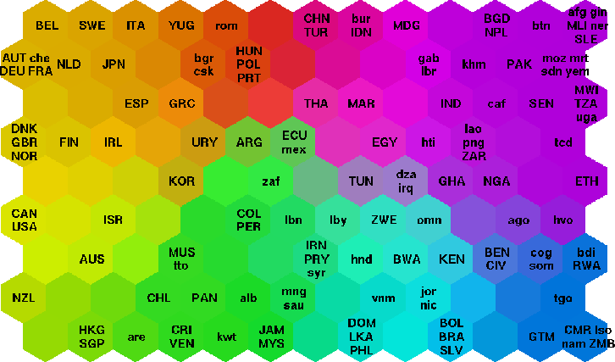
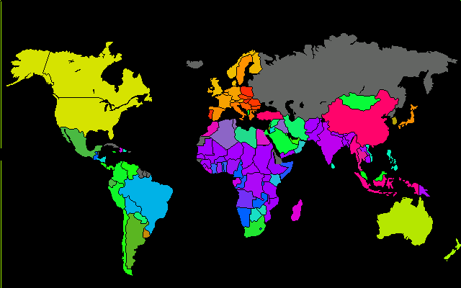
Poverty Map
http://www.cis.hut.fi/research/som-research/worldmap.html

Slide 40
SOM for Classification
A generated map can also be used for classification
Human can assign a class to a data point, or use the strongest weight as the prototype for the data point
For a new test case, calculate the winning node and classify it as the class it is closest to
Handwriting recognition example: http://fbim.fh-regensburg.de/~saj39122/begrolu/kohonen.html

Slide 41
Psychological and Biological Considerations of Neural Networks
Psychological
  Neural network models learn, exhibit some behavior similar to humans, based loosely on brains
  Create their own algorithms instead of being explicitly programmed
  Operate under noisy data
  Fault tolerant and graceful degradation
  Knowledge is distributed, yet still some localization
    Lashley’s search for engrams
Biological
  Learning in the visual cortex shortly after birth seems to correlate with the pattern discrimination that emerges from Kohonen Networks
  Criticisms of the mechanism to update weights; mathematically driven; feedforward supervised network unrealistic

Slide 42
Connectionism
What’s hard for neural networks? Activities beyond recognition, e.g.:
  Variable binding
  Recursion
  Reflection
  Structured representations
Connectionist and Symbolic Models
  The Central Paradox of Cognition (Smolensky et al., 1992):
  "Formal theories of logical reasoning, grammar, and other higher mental faculties compel us to think of the mind as a machine for rule-based manipulation of highly structured arrays of symbols. What we know of the brain compels us to think of human information processing in terms of manipulation of a large unstructured set of numbers, the activity levels of interconnected neurons. Finally, the full richness of human behavior, both in everyday environments and in the controlled environments of the psychological laboratory, seems to defy rule-based description, displaying strong sensitivity to subtle statistical factors in experience, as well as to structural properties of information. To solve the Central Paradox of Cognition is to resolve these contradictions with a unified theory of the organization of the mind, of the brain, of behavior, and of the environment."

Slide 43
Possible Relationships?
Symbolic systems implemented via connectionism
  Possible to create hierarchies of networks with subnetworks to implement symbolic systems
Hybrid model
  System consists of two separate components; low-level tasks via connectionism, high-level tasks via symbols

Slide 44
Proposed Hierarchical Model
Jeff Hawkins
Founder: Palm Computing, Handspring
Deep interest in the brain all his life
Book: “On Intelligence”
  Variety of neuroscience research as input
  Includes his own ideas, theories, guesses
  Increasingly accepted view of the brain

Slide 45
The Cortex
Hawkins’s point of interest in the brain
  “Where the magic happens”
Hierarchically-arranged in regions
Communication up the hierarchy
  Regions classify patterns of their inputs
  Regions output a ‘named’ pattern up the hierarchy
Communication down the hierarchy
  A high-level region has made a prediction
  Alerts lower-level regions what to expect
Notes:
Recognizing pictures, making decisions, functioning with motor skills in reaction to environment, etc…
Most abstract concepts at the top (the big ideas, concepts, etc) and the features, details, pixels of images at the bottom
More on the naming shortly

Slide 46
Hawkins Quotes
“The human cortex is particularly large and therefore has a massive memory capacity. It is constantly predicting what you will see, hear and feel, mostly in ways you are unconscious of. These predictions are our thoughts, and when combined with sensory inputs, they are our perceptions. I call this view of the brain the memory-prediction framework of intelligence.”

Slide 47
Hawkins Quotes
“Your brain constantly makes predictions about the very fabric of the world we live in, and it does so in a parallel fashion. It will just as readily detect an odd texture, a misshapen nose, or an unusual motion. It isn’t obvious how pervasive these mostly unconscious predictions are, which is perhaps why we missed their importance.”

Slide 48
Hawkins Quotes
“Your brain constantly makes predictions about the very fabric of the world we live in, and it does so in a parallel fashion. It will just as readily detect an odd texture, a misshapen nose, or an unusual motion. It isn’t obvious how pervasive these mostly unconscious predictions are, which is perhaps why we missed their importance.”

Slide 49
Hawkins Quotes
“Suppose when you are out, I sneak over to your home and change something about your door. It could be almost anything. I could move the knob over by and inch, change a round knob into a thumb latch, or turn it from brass to chrome…. When you come home that day and attempt to open the door, you will quickly detect that something is wrong.”

Slide 50
Prediction
Prediction means that the neurons involved in sensing your door become active in advance of them actually receiving sensory input.
  When the sensory input does arrive, it is compared with what is expected.
  Two way communication; classification up the hierarchy, prediction down the hierarchy

Slide 51
Prediction
Prediction is not limited to patterns of low-level sensory information like hearing and seeing
Mountcastle’s principle : we have lots of different neurons, but they basically do the same thing (particularly in the neocortex)
  What is true of low-level sensory areas must be true for all cortical areas. The human brain is more intelligent than that of other animals because it can make predictions about more abstract kinds of patterns and longer temporal pattern sequences.”

Slide 52
Visual Hierarchies
Lowest visual level inputs pixels
Second level recognizes edges, lines, etc from known patterns of pixels
Third level recognizes shapes from known patterns of edges, lines, etc
Fourth level recognizes objects from known patterns of shapes

Slide 53
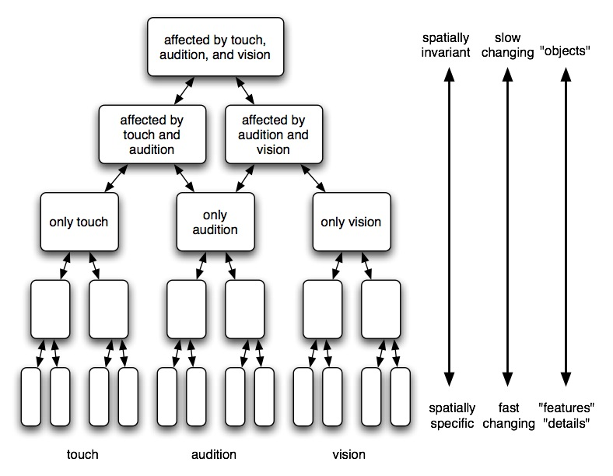
Layers

Slide 54
Not there yet…
Many issues remain to be addressed by Hawkins’ model
  Missing lots of details on how his model could be implemented in a computer
  Creativity?
  Evolution?
  Planning?
  Rest of the brain, not just neocortex?

Slide 55
Links and Examples
http://davis.wpi.edu/~matt/courses/soms/applet.html
http://websom.hut.fi/websom/milliondemo/html/root.html
http://www.cis.hut.fi/research/som-research/worldmap.html
http://www.patol.com/java/TSP/index.html

